Slide 1
Networking -- IP, TCP, BGP
Leonidas Kontothanassis

Slide 2
What do they stand for
IP => Internet Protocol
Names and allows devices to be reached on the Internet or Intranet.
TCP => Transmission Control Protocol
Makes transmission of data between devices reliable, cooperative, and fast.
BGP => Border Gateway Protocol
Allows independent networks to tell each other what devices they contain and how to reach them.

Slide 3
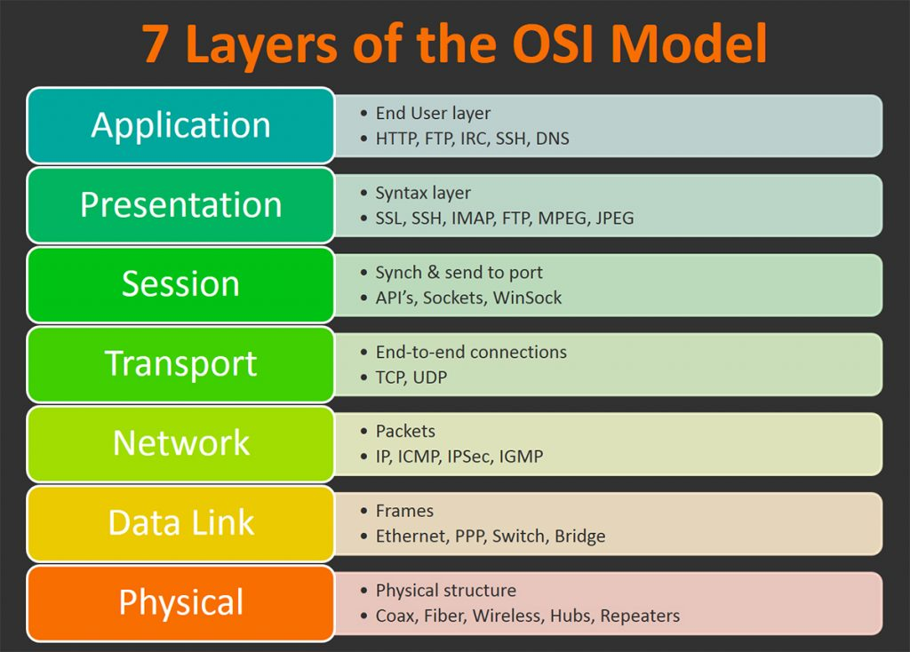
Digression (The OSI model)

Slide 4
IP addresses
IPv4 -- 32 bit addresses commonly written as x.y.z.w with values ranging from 0-255
subnets defined with /. E.g. 10.0.0.0/8 implies all addresses that start with 10. while 10.0.0.0/16 implies all addresses that start with 10.0
IPv6 -- 128 bit addresses commonly written as a:b:c:d:e:f:g:h
prefixes defined with same notation 2001:db1:abc1:0012::0/64 implies all addresses that start with 2001:db1:abc1:0012
first 48 bits identify the network, next 16 bits the subnetwork and last 64 bits the device within the network.
Use arin.net (or ripe.net, apnic.net, lacnic.net, afrinic.net, …) to find out who a particular ip address belongs to. Knows as the Regional Internet Registries (RIRs)
Lower level are NIRs (National Internet Registries) and LIRs (Local Internet Registries)

Slide 5
IP addresses
Class A (x.0.0.0/8). Traditionally those that started with 1-126 but have now been subdivided
Class B (x.y.0.0/16). Traditionally those that started with 128-191
Class C (x.y.z.0/24). Traditionally those that started with 192-223.
Multicast space (224-239).0.0.0/8
Reserved space 240.0.0.0/4

Slide 6
IP addresses
Private IP addresses
0.0.0.0/8 -> Shorthand for the network I am in. Not routable. 0.0.0.0 is the current host.
10.0.0.0/8 -> Private network for very large orgs
100.64.0.0/10 -> Private Network. Used by ISPs with carrier grade NATs
172.16.0.0/12 -> Private network for medium size orgs
192.168.0.0/16 -> Private network for small orgs
192.0.0.0/24 -> Private network for the IETF (NAT64, DNS64)
127.0.0.0/8 -> Localhost addresses
Full list

Slide 7
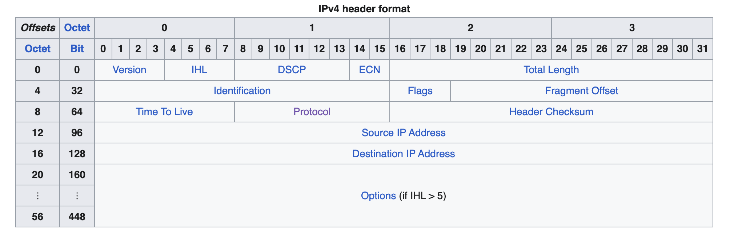
IP Header
Internet Protocol version 4 - Wikipedia
For IPv6 see here

Slide 8
The TCP protocol
Reliable, co-operative, in-order delivery on top of an unreliable medium.
Key concepts:
Sequence numbers
Acknowledgements
Timeouts
Congestion control

Slide 9
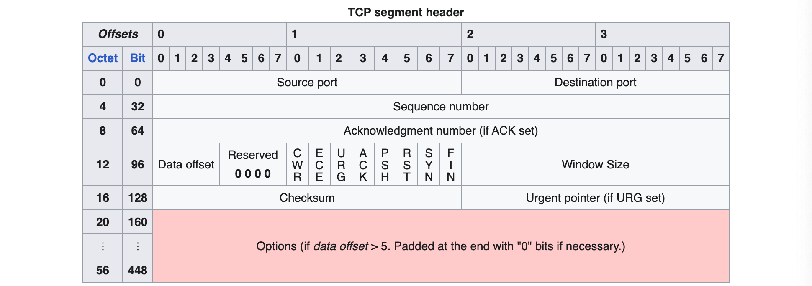
TCP Header
Notes:
SYN, FIN, RST = Start, End, Error
ACK = Got you PSH = Don’t wait to send data to application
URG = Data in packet that is more important (not really used any more)
ECE = Early congestion notification (Not used in the internet but a lot inside DCs)
CWR = Acknowledge the ECE

Slide 10
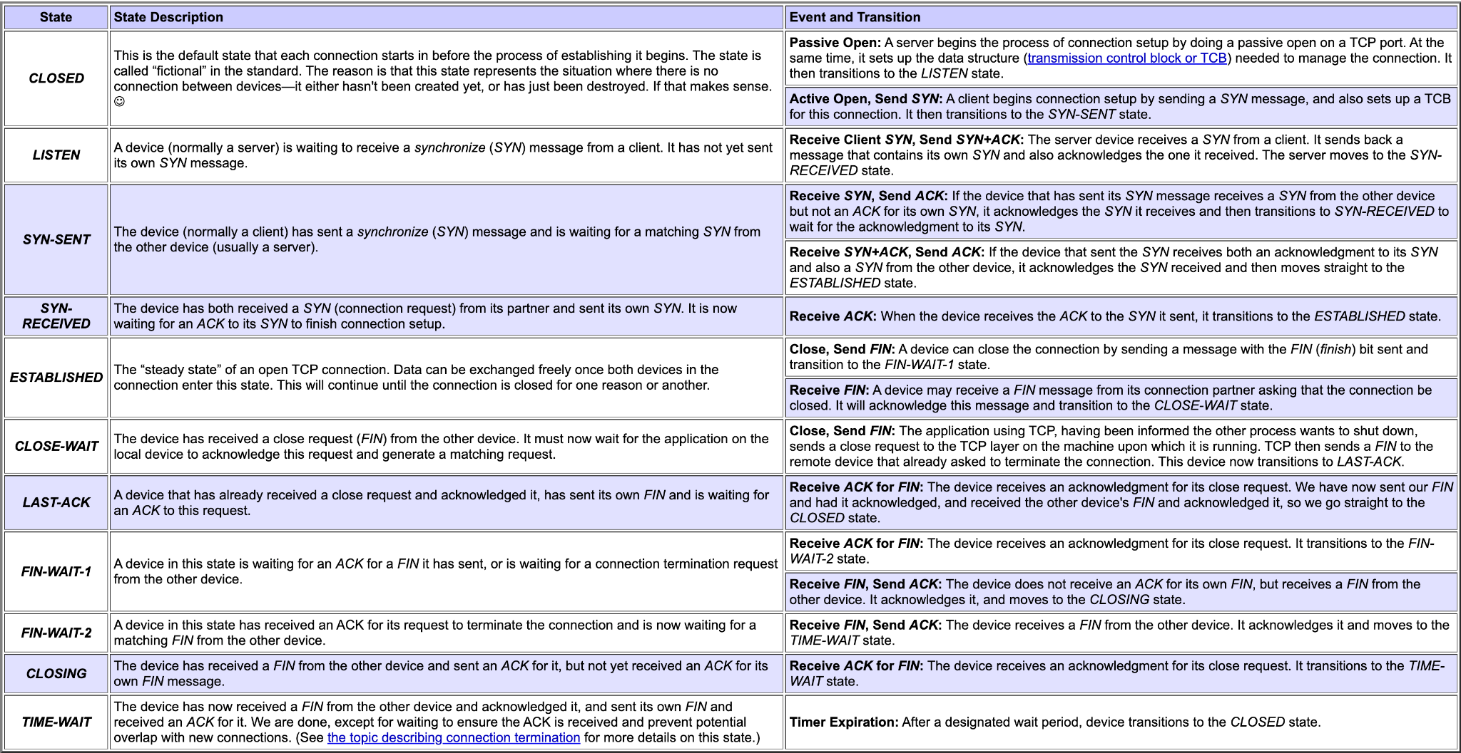
TCP States

Slide 11
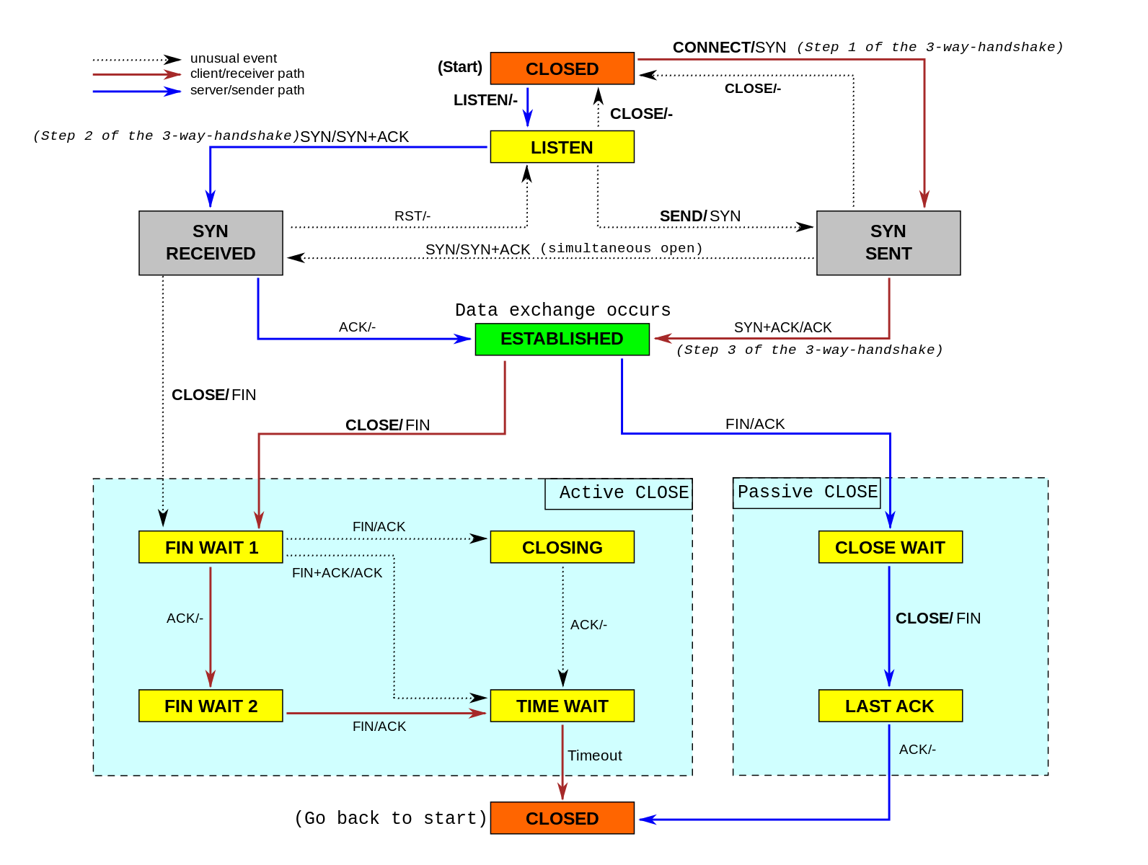
TCP State Diagram

Slide 12
TCP Recovery
When receiving packets in sequence acknowledge sequence number of received packet
When out of order acknowledge sequence number of last in-order packet
Resend packets when receiving a duplicate ack
Resend packets when no ack received after specified timeout.

Slide 13
TCP Congestion control
Congestion window
How many packets in flight?
Start small (slow start)
Increase window when things go well
Decrease window when things go poorly (i.e packet loss)
Some packet loss (i.e. out of order delivery) is considered benign and thus will not reduce window

Slide 14
TCP congestion control
Adjust window based on packet loss (TCP Cubic, most common)
Adjust window based on observed packet latency (TCP Vegas, less common)
Adjust window based on observed throughput (TCP BBR, most recent flavor)
Check https://ieeexplore.ieee.org/document/9811217 for comparisons
Notes:
Remember the max sending rate MSS / (RTT * sqrt(p)).
In reality this only works for packet loss rates between 0.001 and 1%.

Slide 15
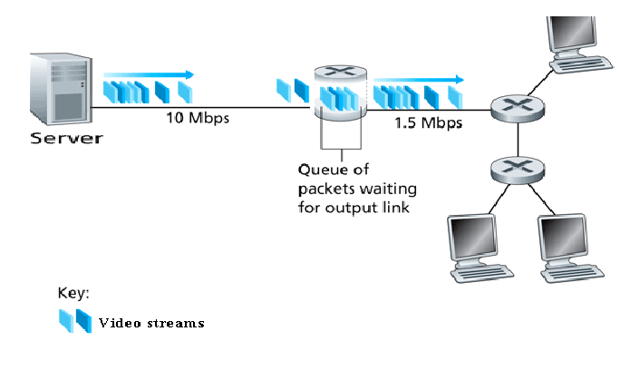
Why do packets get lost?

Slide 16
Further Reading
Nice free resource: https://www.redbooks.ibm.com/redbooks/pdfs/gg243376.pdf

Slide 17
The BGP protocol
IP routes to hosts
TCP makes sure packets are delivered reliably
BGP makes sure the routers know where the hosts are!!

Slide 18
BGP Key concepts
Routes and Autonomous Systems
Within an network the network should know how to reach all host
Can be achieved with iBGP, OSPF, IS-IS or other protocols
The network itself is known to the rest of the internet with a unique number known as its AS number.
The network is connected to the internet using border routers
Peering
Border routers connect directly to each other and tell each other which IP addresses they can provide connectivity to.
Paths
When announcing a route over a peering session the receiving router prepends the received data with the AS for the sending router and propagates that information to other border routers

Slide 19
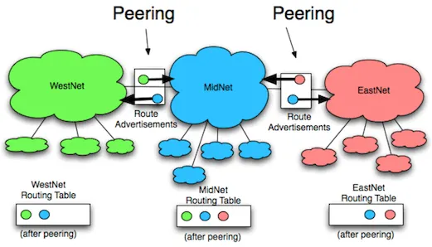
BGP Route exchange
Source: Avi Freedman -- Kentik

Slide 20
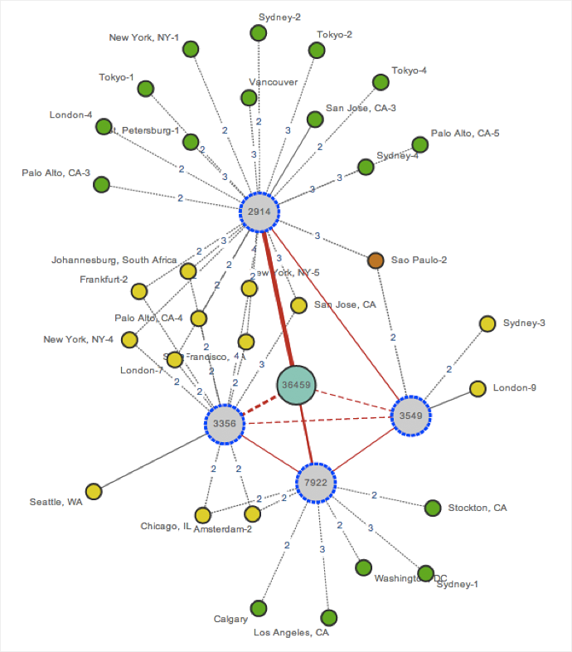
Messy BGP reality

Slide 21
BGP extras
Some hosts can be reached by multiple paths
Prefer most specific path (i.e. a /16 advertisement is preferable than a /8)
Prefer shortest path. If an advertisement is equally specific, shortest AS path is preferred
Community tags
More of a gentleman’s agreement, but widely observed. Attach certain metadata to the advertisement that informs a peer of your preferences.

Slide 22
What OSI layer is BGP?
Layer 4?
Layer 7?
TCP relies on IP which relies on BGP
BGP relies on TCP
Most common answer: BGP operates at layer 4 but controls layer 3

Slide 23
BGP problems
Loops! (must be detected and avoided)
Hijacking: https://www.cnet.com/culture/how-pakistan-knocked-youtube-offline-and-how-to-make-sure-it-never-happens-again/
Asymmetric routes
Internet Blocking and Censorship (in conjunction with other protocols).

Slide 24
BGP ticking time bomb?
Currently ~0.9 million IPv4 routes and 0.1 million IPv6 routes
Most deployed routers can handle a little more than 1 million IPv4 and 0.15 million IPv6 routes
The internet could break spectacularly, if limits are exceeded but ISPs and administrators are aware and managing appropriately.

Slide 25
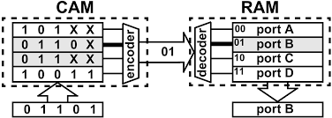
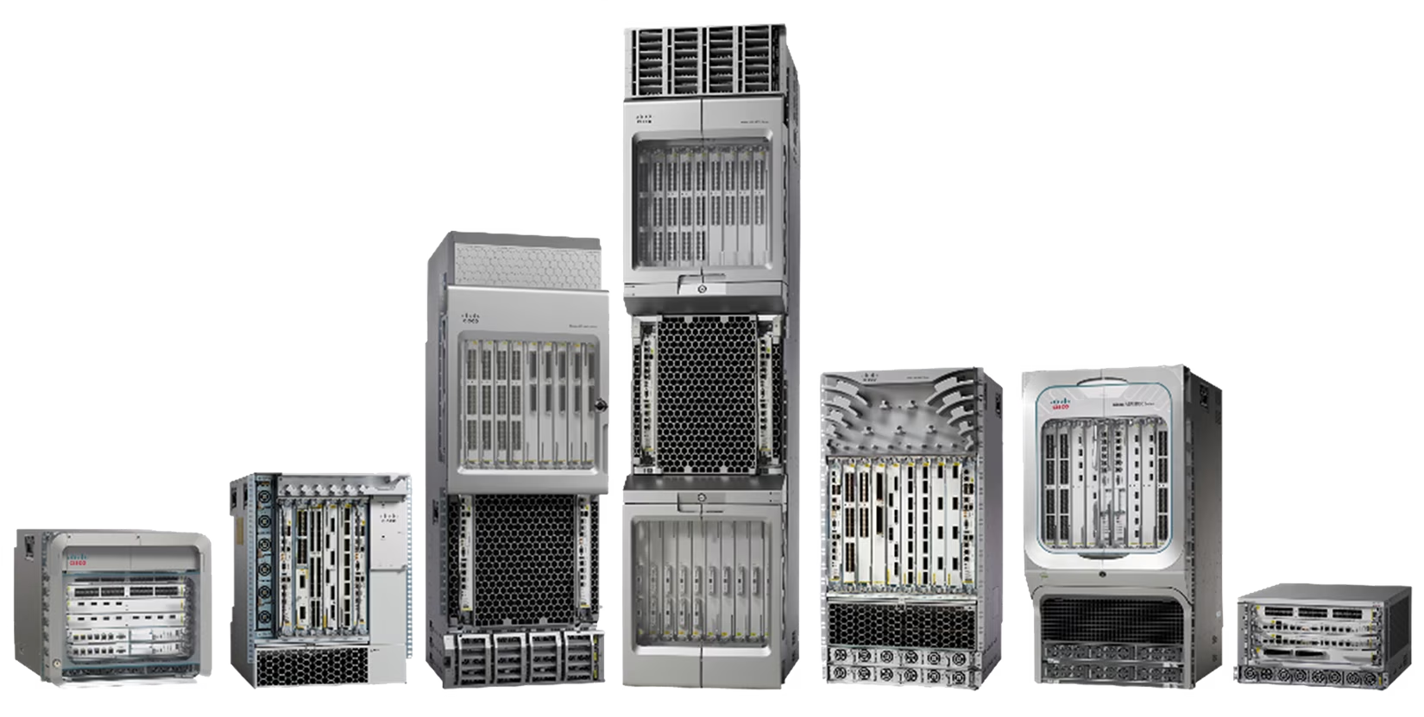
How do Routers work?
Router matches destination address in IP packet with all routes installed in its CAM
Most specific match (bitwise XNOR where all values are 1 and have the fewest Xs) wins.
The entry that wins identifies the output port on the router and the packet gets forwarded to that port
Up to 16 line cards, with up to 48 ports each

Slide 26
What is CAM?
Typical memory: Given an address return the contents of that address
Content addressable memory: Given a value, return the address that best matches that value

Slide 27
Attendance Poll
https://piazza.com/class/mkctevprups13o/post/148

